Slide 1
Unit-5
Cloud Database
Part-2

Slide 2
Contents
Cloud Database- Operational Model for Cloud Database, Types of Cloud Database
Cloud File System- Distributed File System Basics, Concept of GFS and HDFS, Comparison of Features

Slide 3
Cloud Database
A cloud database is a database service built and accessed through a cloud platform. It serves many of the same functions as a traditional database with the added flexibility of cloud computing.
Key features:
A database service built and accessed through a cloud platform
Enables enterprise users to host databases without buying dedicated hardware.
There are some SQL-based and some NoSQL- based databases offering.
Accessed through a web interface or vendor-provided API.

Slide 4
Operation Model for Cloud Database
There are two primary methods to run a database on a cloud platform:
Virtual Machine image: Cloud platforms allow users to purchase virtual-machine instances for a limited time, and one can run a database on such virtual machines. Users can either upload their own machine image with a database installed on it, or use ready-made machine images that already include an optimized installation of a database.
Database-as-a-service (DBaaS): With a database as a service model, users pay fees to a cloud provider for services and computing resources, reducing the amount of money and effort needed to develop and manage databases.Users are given tools to create and manage database instances, and control users. Some cloud providers also offer tools to manage database structures and data. Many cloud providers offer both relational (Amazon RDS, SQL Server) and NoSQL (MongoDB, Amazon DynamoDB) databases. This is a type of software as a service (SaaS).

Slide 5
Architectural and common Characteristics
Fast Deployment: Cloud databases are the perfect choice when you urgently need a database, as they can be up and running in minutes. Cloud databases eliminate the need to purchase and install hardware and set up a network.
Accessibility: Users have quick access to cloud databases remotely through the provider's API or web interface.
Scalability: You can expand cloud database storage capacity without disruptions and meet the requirements. Cloud database scalability is seamless due to DBaaS implementation, which is a major benefit for growing businesses with limited resources.
Disaster Recovery: Data backups are regularly performed on cloud databases and kept on remote servers. These backups enable a business to stay online in cases of natural disasters, equipment failure, etc.

Slide 6
Lower Hardware Costs: Cloud database service providers supply the infrastructure and perform database maintenance. Hence, companies invest less in hardware and have fewer IT engineers for database maintenance.
Value for Money: Many DBaaS solutions are available in multiple configurations, allowing companies only to pay for what they use and turn off services when they don't need them. Cloud databases also save money by not requiring operational costs or expensive upgrades.
Latest Tech: Cloud database providers upgrade infrastructure and keep it updated with new tech. This brings significant savings as companies don't have to allocate funds on new tech or staff training.
Security: Most cloud database providers encrypt data and invest in the best cloud security solutions to keep the databases safe. Although there is no impenetrable security system, it is a safe way to protect data. Since cloud database providers use automation to enforce the best security practices, there is less room for human error compared to using on-premises databases.

Slide 7
Cloud Database Vendors
Microsoft Azure
Amazon Web Service (AWS)
Oracle
Google Cloud
Rackspace

Slide 8
Types of Cloud database
It is also important to differentiate between cloud databases that are relational as opposed to non-relational or NoSQL.
The details of each type of cloud database are discussed in the following subsections:
Cloud Relational Databases
Cloud NoSQL Databases

Slide 9
Cloud Relational Database
Microsoft Azure: Microsoft Azure cloud database is one of the most popular and globally widespread cloud platforms. In a nutshell, Azure is a cloud computing platform for VM creation, building and running web-based applications, smart client applications, and XML web services. It currently boasts the biggest and strongest global infrastructure, with 55 regions, more than any other cloud provider.
Weaknesses: Iffy Customer Service, Not User Friendly

Slide 10
Oracle Database provides companies with enterprise-scale database technology stored in the cloud. Despite its first offering being quite comprehensive, the Generation 2 offering has consistently higher performance with extensive governance and security controls.
Data migration is also covered with a dedicated solution and tight customer support in case any technical issues or questions arise.
Weaknesses: No Free Version, Pricey for Small Companies

Slide 11
Amazon Web Service (AWS): AWS is one of the market leaders when it comes to DBaaS. Amazon offers various services for data management and integration. In Amazon RDS: Amazon Relational Database Service runs on either Oracle, SQL, or MySQL server instances. In Amazon SimpleDB. Designed for smaller workloads, SimpleDB is primarily a schema-less database.
Weaknesses: Not Too Customizable, Downtimes as per Amazon’s Schedule (The downside is that scaling and patching operations require downtime.)

Slide 12
Google Cloud: Surprisingly, Google is still playing catch-up with the big players in the market. But its solutions are being adopted by more and more businesses of different sizes, thanks to its no-nonsense approach and comprehensive documentation which reduces stress on developers, IT professionals, and other stakeholders.
The broad open-source compatibility also has its fair share of benefits, allowing you to scale while doing more with analytics and integrations.
Strengths: Comprehensive Documentation, Good for Small and Big Businesses Weaknesses: Not Yet at the Level of the Big Three (AWS, Oracle, Azure) The downside is a lack of managed services and the high prices, including a costly support fee.

Slide 13
IBM Db2 on Cloud: IBM Db2 on Cloud is a fully managed SQL database featuring a 99.99% uptime SLA, independent storage and compute scaling through UI and API, several disaster-recovery options, data encryption, and other features.
IBM's relational database offers advanced data management and analytic capabilities for transactional and warehousing workloads. This database delivers high performance, boasts great insights, data availability, reliability, and broad operating system support.
The downside of IBM Db2 is that it has fewer regional options, affecting performance in some cases.

Slide 14
Rackspace: Rackspace offers scalable, fully managed, or hosted cloud databases, characterized by high performance and a storage area network (SAN) based on the OpenStack platform.
Rackspace offers easy access to your cloud database via Cloud Control Panel, CLI (command Line Interface) or API, and features regular backups of all cloud databases.
Redundant storage and synchronous data replication ensure data protection in case of disaster or hardware failure.
The downside is a smaller number of data centers compared to the competition.

Slide 15
Cloud NoSQL Databases
NoSQL database is “ not only SQL” database. The evolution of NoSQL database started in early 2009 and has been growing rapidly since because of some limitations with relational databases.

Slide 16
Limitations with Existing Database
There are certain limitations with our traditional database system and they cannot fit into the current scenario of big data- related application because data is growing exponentially in every industry. Traditional databases are not capable of handling such data growth, which is now in terabytes(TB) and petabytes(PB).

Slide 17
Traditional databases are unable to:
Store data in TB/PB; even a a good processor cannot process millions of rows.
Process TB of data on a single machine.
Be scalable after a certain limit.

Slide 18
Types of NoSQL Database
Here are the four main types of NoSQL databases:
Document databases. (e.g MongoDB, CouchDB)
Key-value stores.(AWS DynamoDB)
Column-oriented databases.(Apache Hbase, Cassandra)
Graph databases.(Neo4j)

Slide 19
Document-based database :The document-based database is a nonrelational database. Instead of storing the data in rows and columns (tables), it uses the documents to store the data in the database. A document database stores data in JSON(JavaScript Object Notation), BSON(Binary Javascript Object Notation), or XML(extensible markup language) documents.
Documents can be stored and retrieved in a form that is much closer to the data objects used in applications which means less translation is required to use these data in the applications. In the Document database, the particular elements can be accessed by using the index value that is assigned for faster querying.

Slide 20
Key Values: A key-value store is a nonrelational database. The simplest form of a NoSQL database is a key-value store. Every data element in the database is stored in key-value pairs. The data can be retrieved by using a unique key allotted to each element in the database. The values can be simple data types like strings and numbers or complex objects.
Column-oriented database: It is a non-relational database that stores the data in columns instead of rows. That means when we want to run analytics on a small number of columns, you can read those columns directly without consuming memory with the unwanted data.
Columnar databases are designed to read data more efficiently and retrieve the data with greater speed. A columnar database is used to store a large amount of data.

Slide 21
Graph-Based databases:
Graph-based databases focus on the relationship between the elements. It stores the data in the form of nodes in the database. The connections between the nodes are called links or relationships.

Slide 22
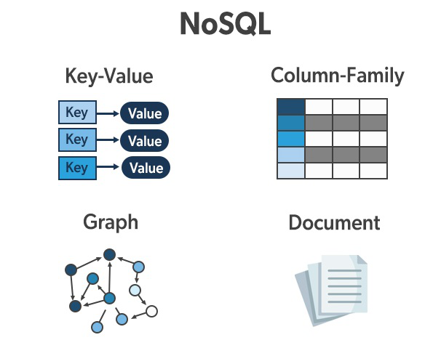

Slide 23
Most popular and widely adopted NoSQL Database
MongoDB Atlas : MongoDB Atlas is a cloud database created and managed by the same team that developed MongoDB.
Mongo’s cloud database is a fully managed NoSQL database that features flexibility, scaling, sharding, and database management automation. It allows most developers to go through various delivery models without requiring help from a database administrator.
The downside is that MongoDB Atlas is NoSQL only, which means that SQL-reliant applications are not an option with this database.

Slide 24
Amazon DynamoDB - DynamoDB is one of the most popular no SQL database of the Amazon which is based on the key value data store. It was first developed for an internal purpose like handling customer related big data applications.
It is built on the top of a single solid state device architecture therefore it scales according to the data in the system .
It provides very high quality reliable throughput and single digit millisecond latency which is preferred in building fast gaming and analytics based applications

Slide 25
Dynamic cassandra - It delivers first performance high availability and scalability with dynamic schema.
It is designed specifically for handling real time Data Analytics related high workload without a single point of failure.
It offers high data availability and quick scalability to many Enterprises.

Slide 26
CouchDB- CouchDB NoSQL database is completely web oriented.
It stores the data in javascript Object Notation document format which can be accessed using JSON API.
It work for all types of web and mobile apps.

Slide 27
Apache HBase- Apache hbase is mostly used in Hadoop related projects.
HBase is another subproject of Apache Foundation which is strongly associated with the Hadoop ecosystem.
It is used to write and update data in real time and can be placed as a traditional database.
HBase also provides various API which supports many operations using application programming languages.

Slide 28
Neo 4J- It is most popular graph Database used in various mission-critical applications. It is the preferred choice of many startups and midsize Organisation across the globe.
It's highly robust and scalable database comprises ACID properties.
Because it provides high availability clustering with a graph query language the customer can easily import the data into CSV format it also supports advanced monitoring.

Slide 29
Cloud file system
A cloud file system is a hierarchical storage system in the cloud that provides shared access to file data. Users can create, delete, modify, read, and write files, as well as organize them logically in directory trees for intuitive access.

Slide 30
Distributed file system Basics
A distributed file system (DFS) is a file system that spans across multiple file servers or multiple locations, such as file servers that are situated in different physical places. Files are accessible just as if they were stored locally, from any device and from anywhere on the network. A DFS makes it convenient to share information and files among users on a network in a controlled and authorized way.

Slide 31
An internet search engines is the most common example of DFS which is used for indexing millions of web pages.
There are a numbers of DFS that solve this problem in different ways. Some popular file system are:
Andrew file system(AWS)
Network file system (NFS)
Coda
Microsoft distributed file system (MDFS)
Apple filling protocol (AFP)
Google file system (GFS)
Hadoop distributed file system (HDFS)

Slide 32
Google file system (GFS)
Google File System (GFS), a scalable distributed file system (DFS), to meet the company’s growing data processing needs.
GoogleFS is another name for GFS. It manages two types of data namely File metadata and File Data.
The GFS node cluster consists of a single master and several chunk servers that various client systems regularly access. On local discs, chunk servers keep data in the form of Linux files. Large (64 MB) pieces of the stored data are split up and replicated at least three times around the network. Reduced network overhead results from the greater chunk size.

Slide 33
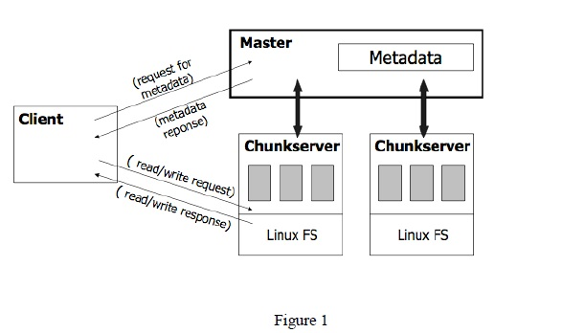
Google File System Architecture

Slide 34
Components of GFS
A group of computers makes up GFS. A cluster is just a group of connected computers. There could be hundreds or even thousands of computers in each cluster. There are three basic entities included in any GFS cluster as follows:
GFS Clients: They can be computer programs or applications which may be used to request files. Requests may be made to access and modify already-existing files or add new files to the system.
GFS Master Server: It serves as the cluster’s coordinator. It preserves a record of the cluster’s actions in an operation log. Additionally, it keeps track of the data that describes chunks, or metadata. The chunks’ place in the overall file and which files they belong to are indicated by the metadata to the master server.
GFS Chunk Servers: They are the GFS’s workhorses. They keep 64 MB-sized file chunks. The master server does not receive any chunks from the chunk servers. Instead, they directly deliver the client the desired chunks. The GFS makes numerous copies of each chunk and stores them on various chunk servers in order to assure stability; the default is three copies.

Slide 35
HDFS
HDFS is a DFS based on GFS that provides high throughput access to application data.
It uses the commodity hardware with the expectation that failure will occur and provide portability across heterogeneous hardware and software platforms
Hdfs is acquired by Hadoop Apache open source project which is very popular these days for its ability to handle big data.

Slide 36
The hadoop-core consists of two modules:
Hadoop distributed file system: Used for storing huge amount of data.
MapReduce programming mode: Used for processing of large set of data.

Slide 37
Hadoop Distributed File System
Hadoop is a DFS based on GFS that provides high throughput access to application data. Provides two main fetaures:
Fault tolerance
Portability.

Slide 38
HDFS Architecture
Namenode
Metadata ops
Client
Read
Datanodes
Datanodes
B
replication
Blocks
Rack1
Write
Rack2
Client

Slide 39
Hadoop Distributed File System Architecture
Master/slave architecture
HDFS cluster consists of a single Namenode, a master server that manages the file system namespace and regulates access to files by clients.
There are a number of DataNodes usually one per node in a cluster.
The DataNodes manage storage attached to the nodes that they run on.
HDFS exposes a file system namespace and allows user data to be stored in files.
A file is split into one or more blocks and set of blocks are stored in DataNodes.
DataNodes: serves read, write requests, deletion, and replication upon instruction from Namenode.
Note: chunk size is 128 MB

Slide 40
